Slide 1

Customer Booking Prediction

Slide 2
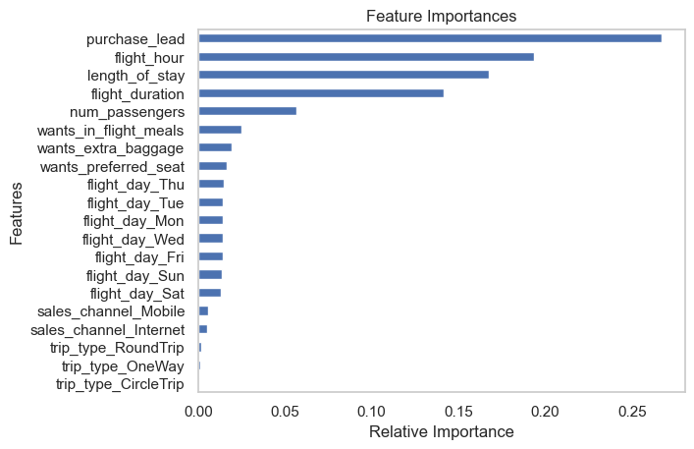
The most important feature of the model was the ‘purchase lead’, that is the time interval between purchase and departure.
Other important parameters of the model came from the flight information such as duration of the flight, time of flight (hours), etc. Sales channel and type of trip were found to be of little significance.
The accuracy of the trained model was 82.9%.
Recall: 0.14 ; Precision: 0.31; For Customers who completed their booking.
The dataset should be enriched with more customer centric features or booking information such as date of purchase (to track holidays, seasons, etc.), if any offers were availed, etc.
Fig: Dependency between the features and the target variable.

